Slide 1
Smriti Kalra
Purpose
Ambition
Growth
Innovation
Adaptability
Excellence
Equity Alliance
Moral Courage

Slide 2
Elaff Abudawood
Equity
Fulfillment
Motivation
Gratitude
Help People
Imagination
Patients First
Work-Life-Balance

Slide 3
Felipe Alvarez
Serenity
Positivity
Golden Rule
Tolerance
Loyalty
Truth
Humanity
Justice

Slide 4
Khalid Bin Salamah
Pleasure
Humility
Self-esteem
Purpose
Persistence
Affirmation
Collaboration
Education

Slide 5
Tatika Catipay
Actualization
Freedom
Zen
Valued
Fairness
Relationship
Respect
Compassion

Slide 6
Christina Chao
Zen
Connected to the Universe
Actualization
Adventure
Wisdom
Satisfaction
Stability
Focus

Slide 7
Rashida Elbourne
Ecstasy
Valued
Accomplishment
Wisdom
Education
Hard Work
Maximize income
Fortitude

Slide 8
Shawki Gholmie
Heart
Achievement
Moral Courage
Innovation
Education
Fortitude
Accomplishment
Maximize income

Slide 9
Jeanie Kim
Happiness
Recognition
Fun
Pride
Integrity
Success
Excel
Critical Thinking

Slide 10
Andrea Mangia
Serenity
Freedom
Pride
Integrity
Honesty
Confidence
Patient Centered
Discipline

Slide 11
Tomasz Orzechowski
Bravery
Communication
Health
friendship
Motivation
Honesty
Bliss
Zen

Slide 12
Tru Patel
Harmony
Integrity
Community
Excellence
Curiosity
Growth
Reliability

Slide 13
Lejla Radoncic
Character
Strength
Knowledge
Success
Logic
Critical thinking
Rigor
Uniqueness
Resilience

Slide 14


Slide 15
Chelsea Rennhoff
Happiness
Make a Difference
Warmth
Agency
Relationship
Hard Work
Courage
Adventure

Slide 17
Gregori Smerczak
Passion
Mindfulness
Make a Difference
Growth
Collaboration
Perseverance
Reliability
Diligence

Slide 18
Karen Smreker
Moral Beauty
Inclusion
Moral Beauty
Balance
Service
Patience
Validation
Unconditional Love

Slide 19
Sophia Sule
Feel Good
Excellence
Legacy
Quality
Resilience
Make a Difference
Rexpect
Responsibility
Mentoring

Slide 20
Gustavo Tipacti Almora
Greatness
Friends & Family
Feeling Alive
Consistency
Perseverance
Nature
Humor
Humor

Slide 21
Weike Wu
Fulfillment
Golden Rule
Motivation
Enthusiasm
Determination
Giving
Reflection
Help People

Slide 22
Omar Zaman
Excellence
Professionalism
Affection
Responsibility
Diligence
Accountability
Transparency

Slide 23
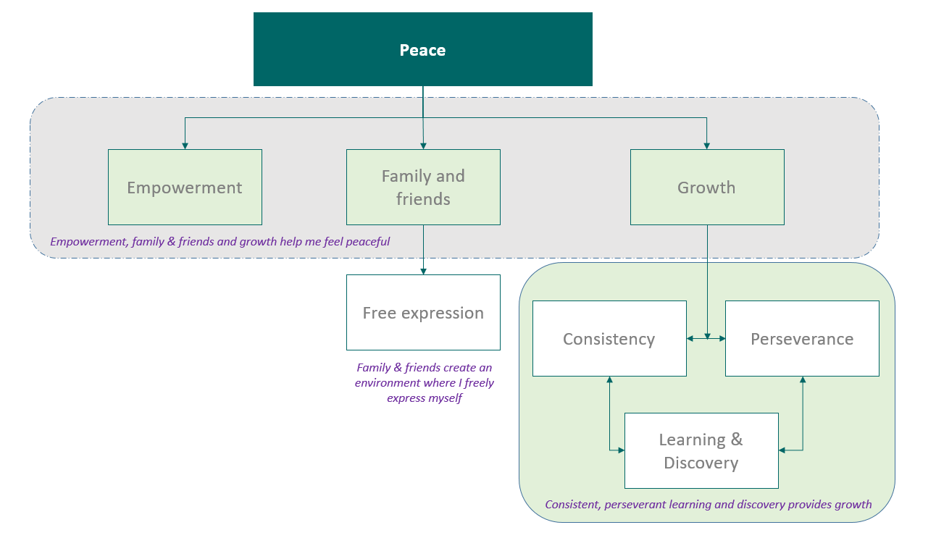
Dilbar Ahmadli

Slide 24
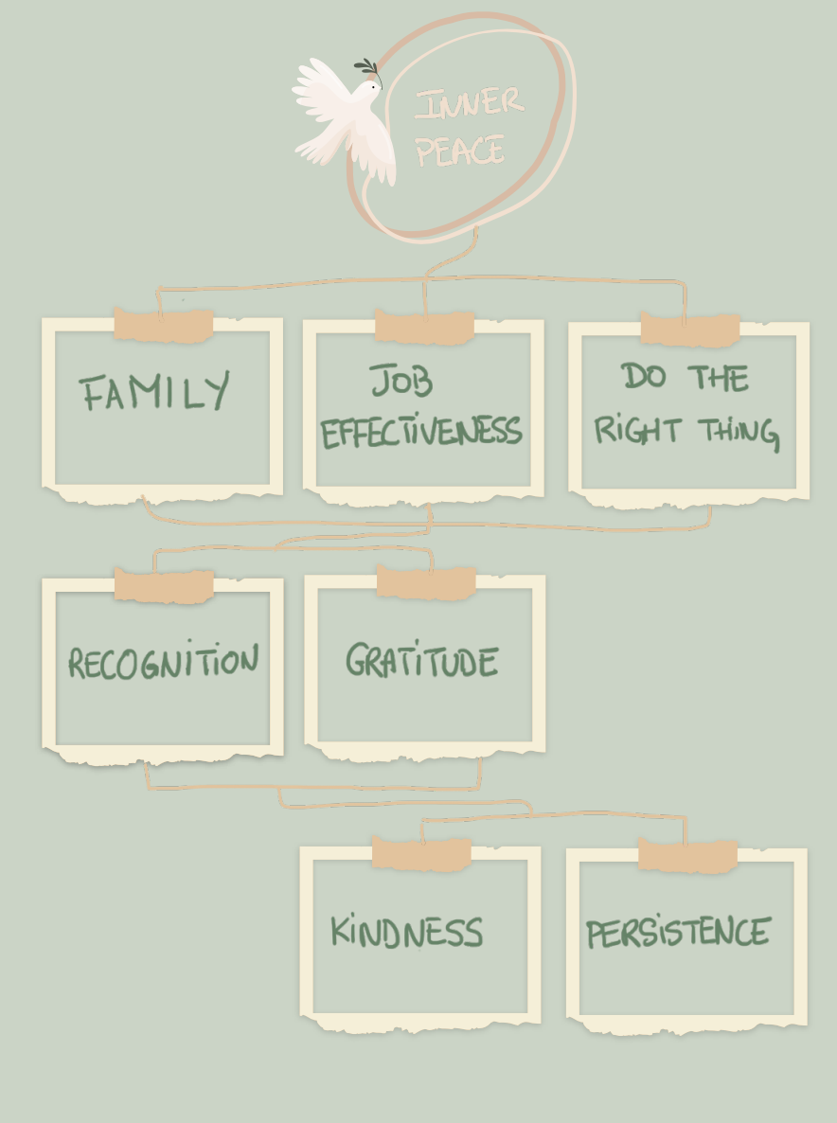
Sandrine Hoeur

Slide 25
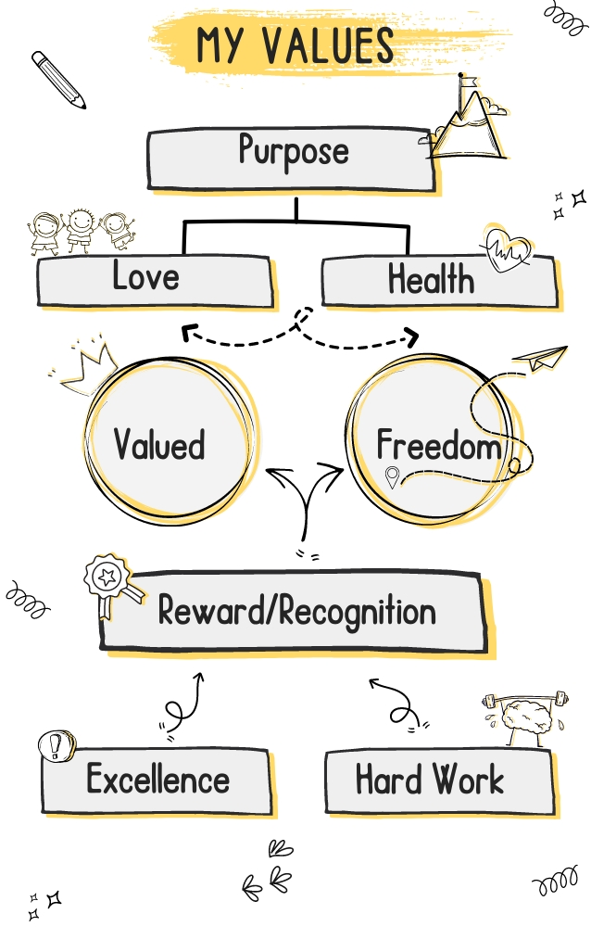
Anisha George

Slide 26

Mouli Chakravarty

Slide 27
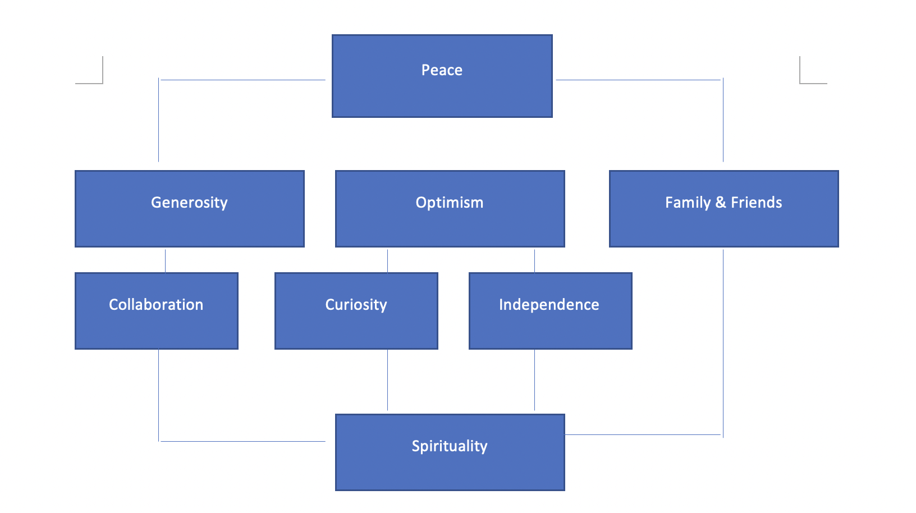
Andres Briseno Rodriguez

Slide 28
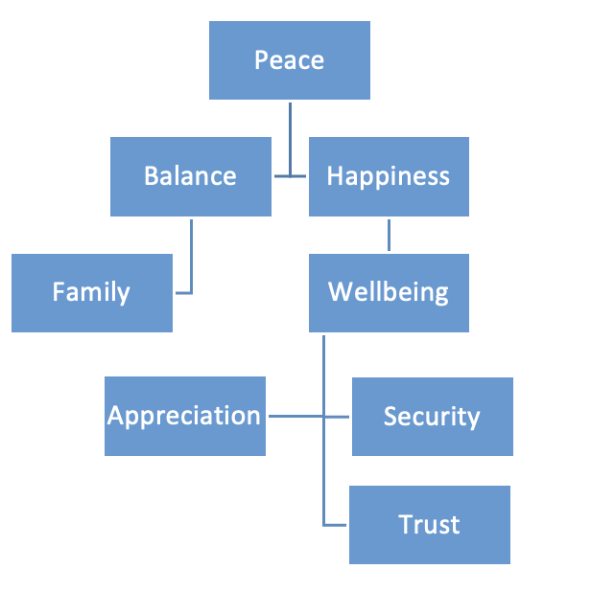
Sevinj Abdullayeva

Slide 29
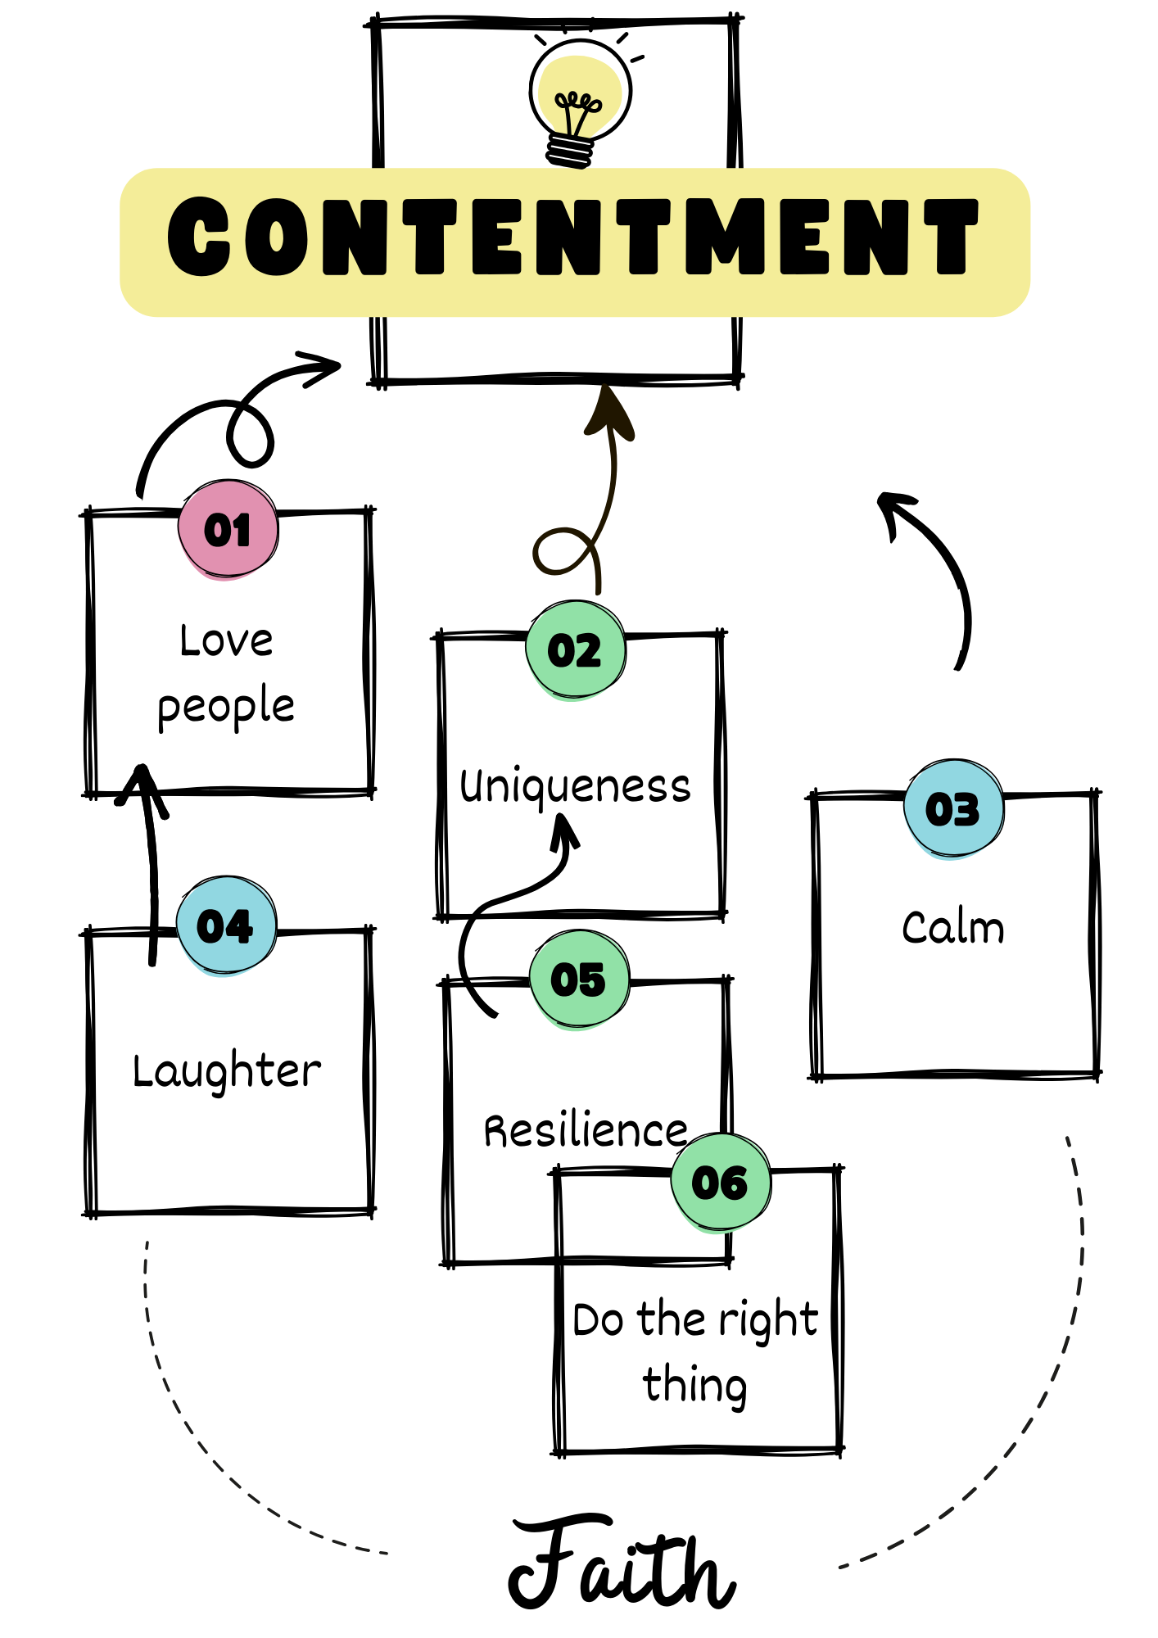
Fab Kouaghu

Slide 30
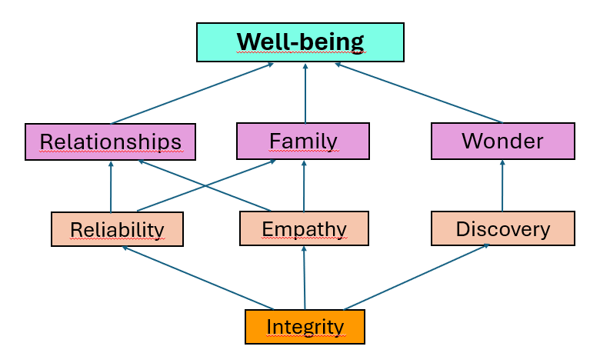
Lucero Loera

Slide 31
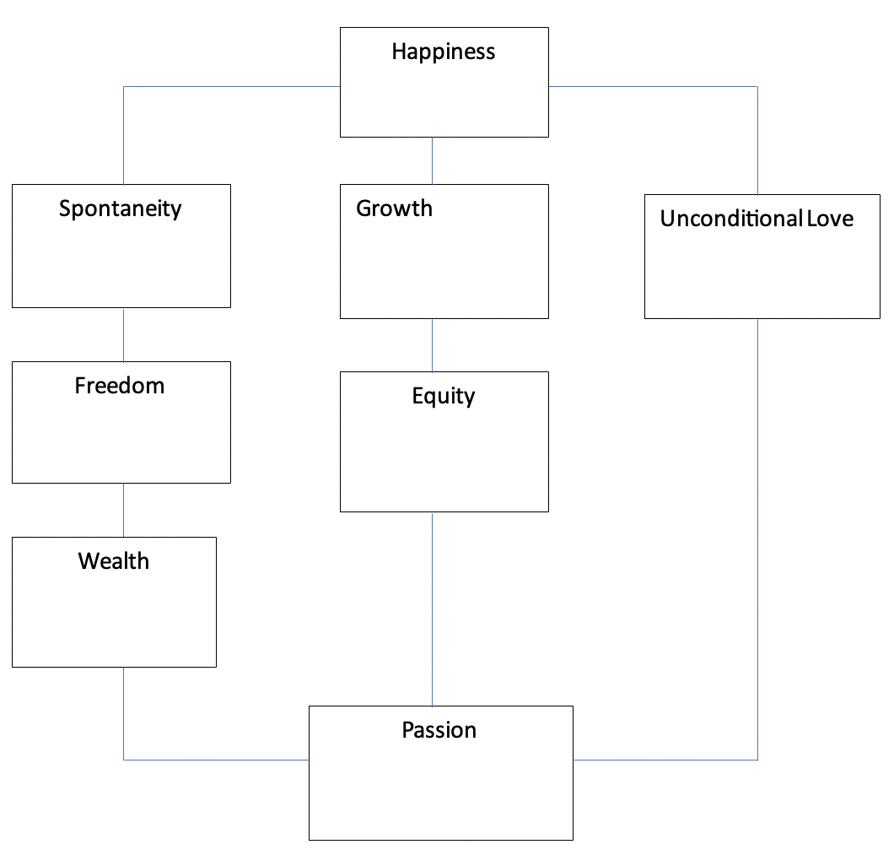
Jamechia “JD” Hoyle

Slide 32
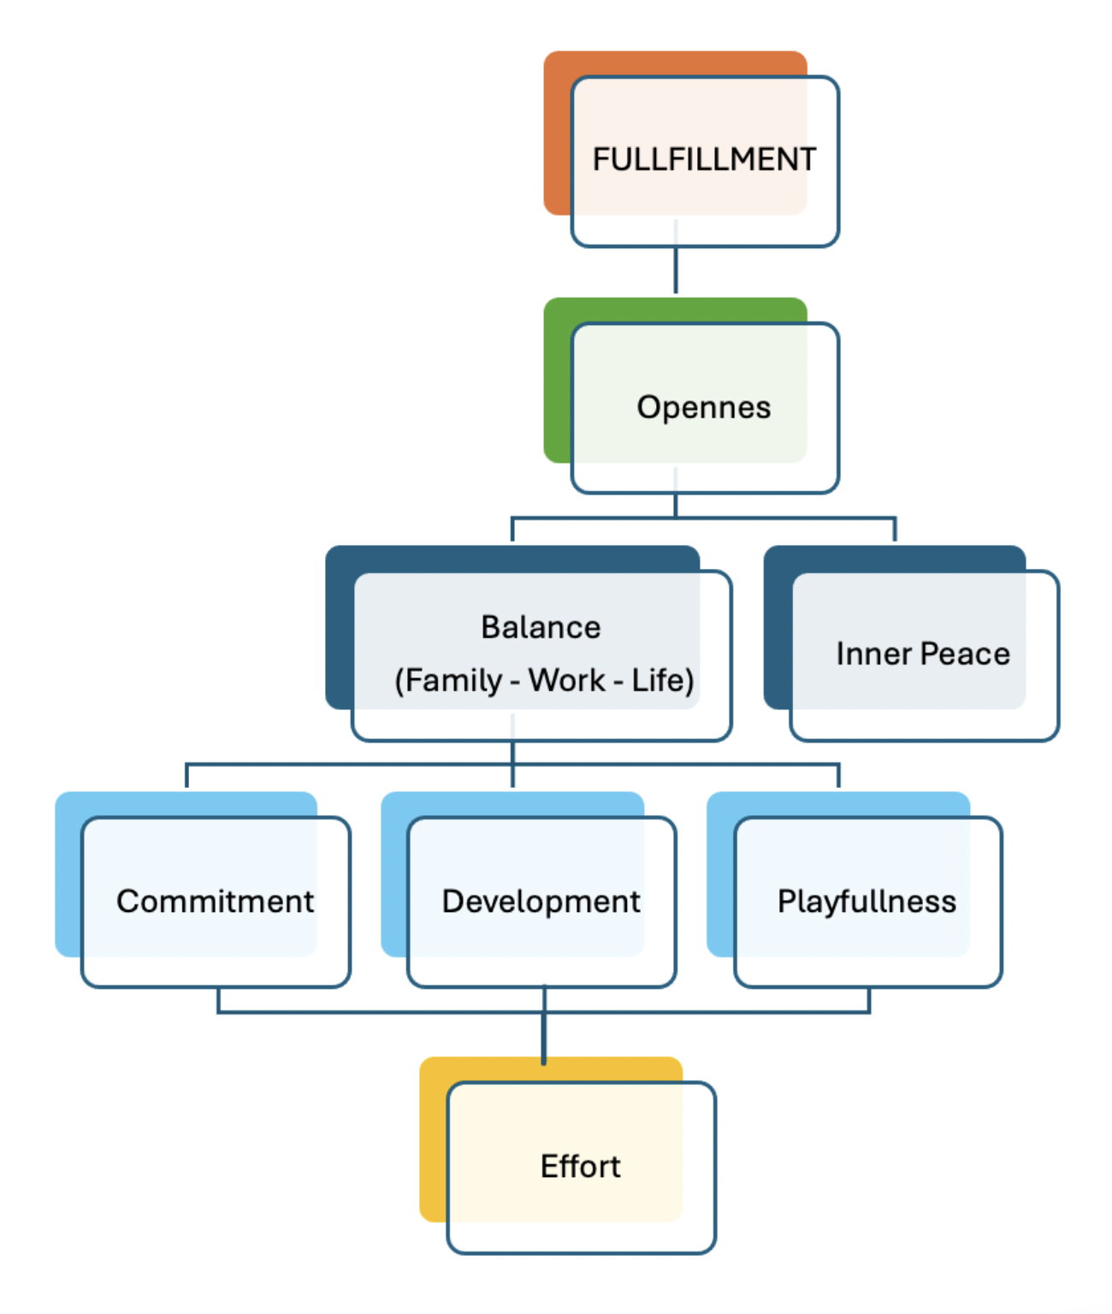
Fermin Montemayor Santos

Slide 33
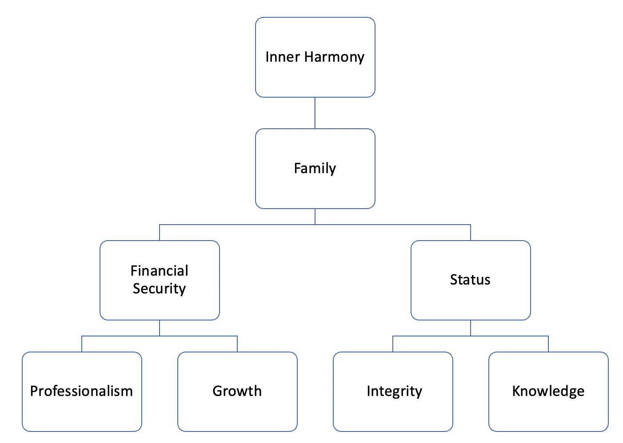
Bakhtiyar Shikhzadayev

Slide 34
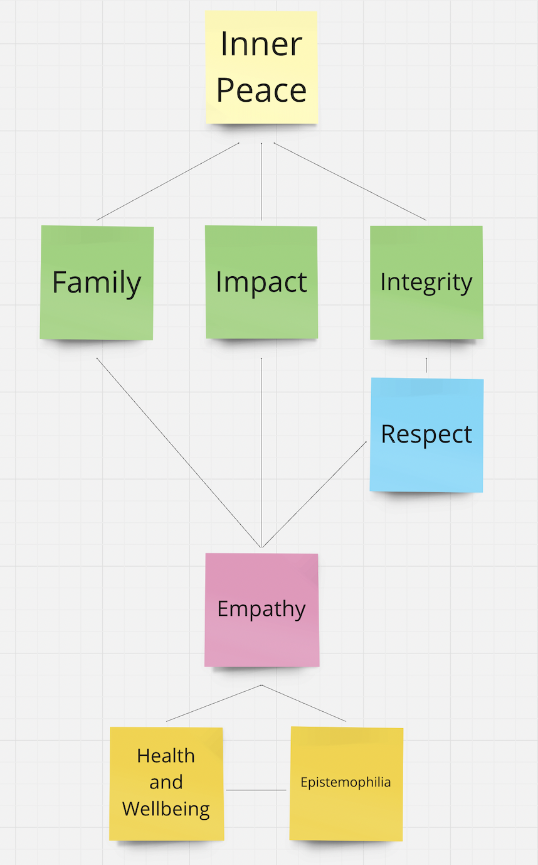
Uzair Rashid

Slide 35
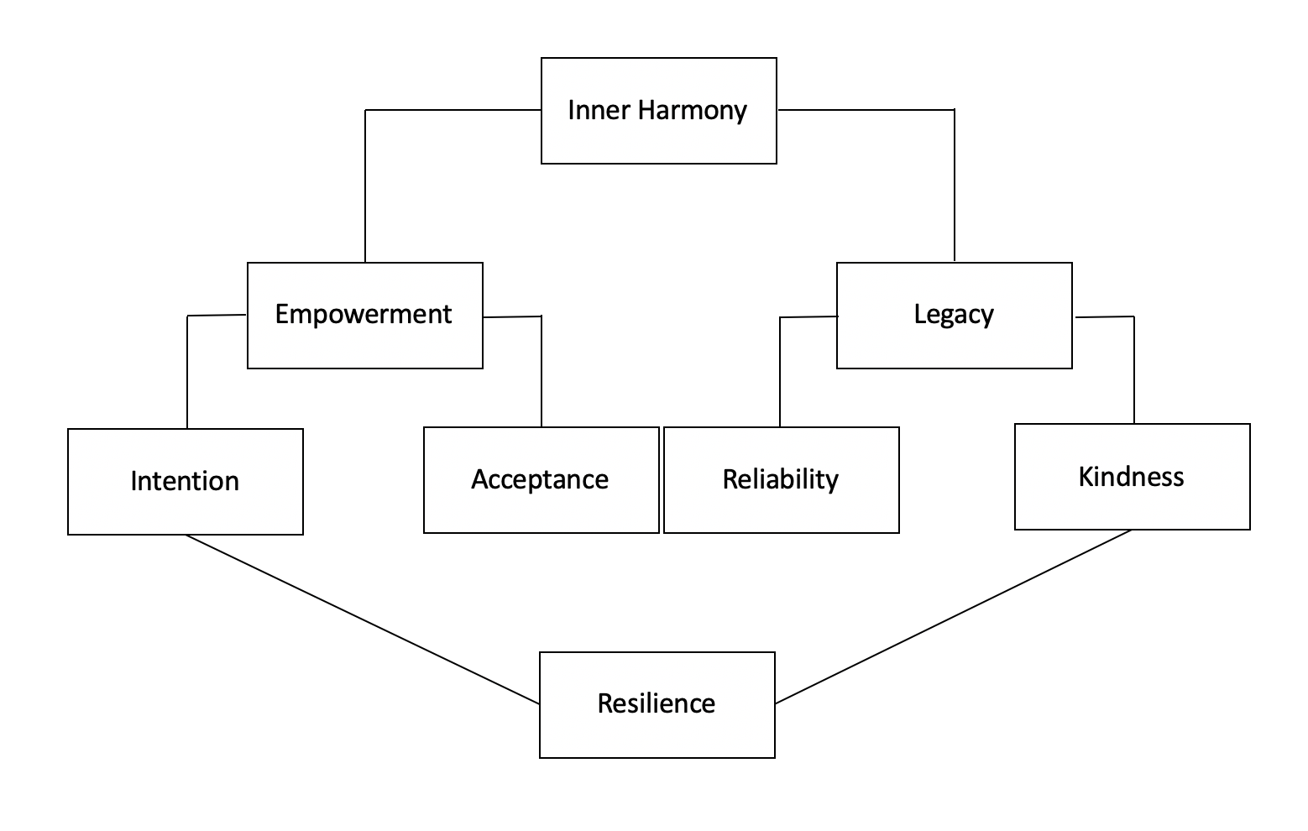
Victoire Stamoulis

Slide 36
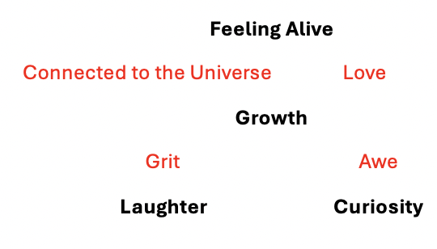
Jake Taub

Slide 37
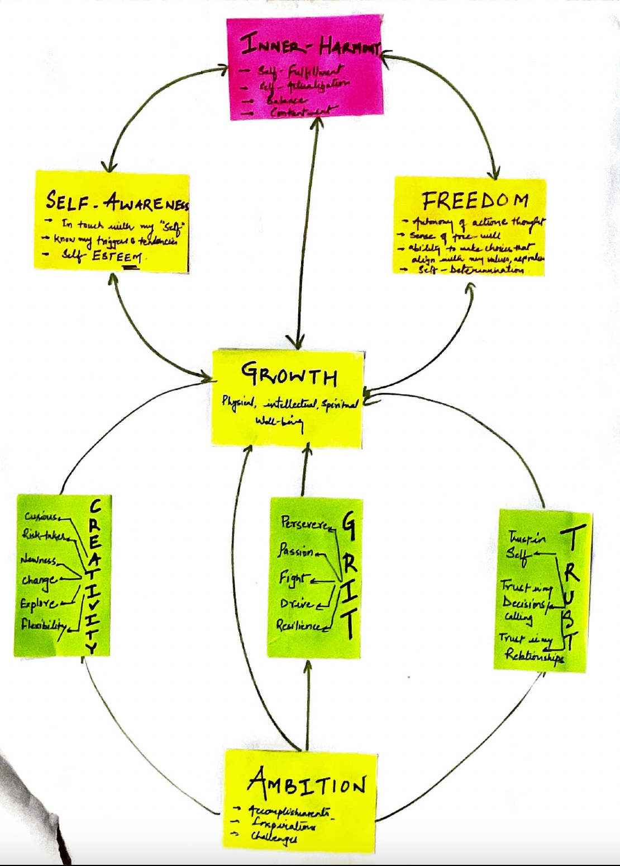
Abhishek Singh

Slide 38
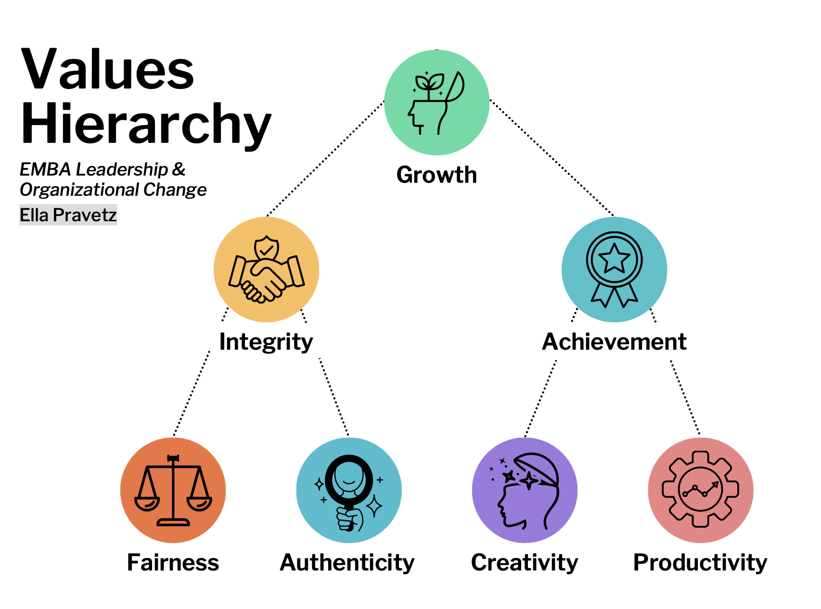
Ella Pravetz

Slide 39
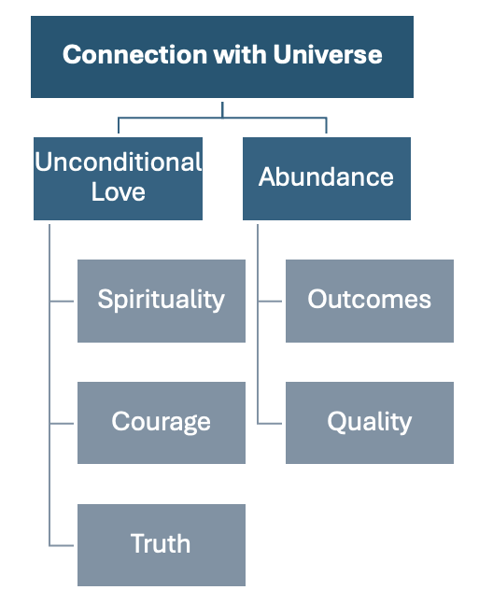
Christy Wang

Slide 40
Adeline Wijayanti

Slide 41
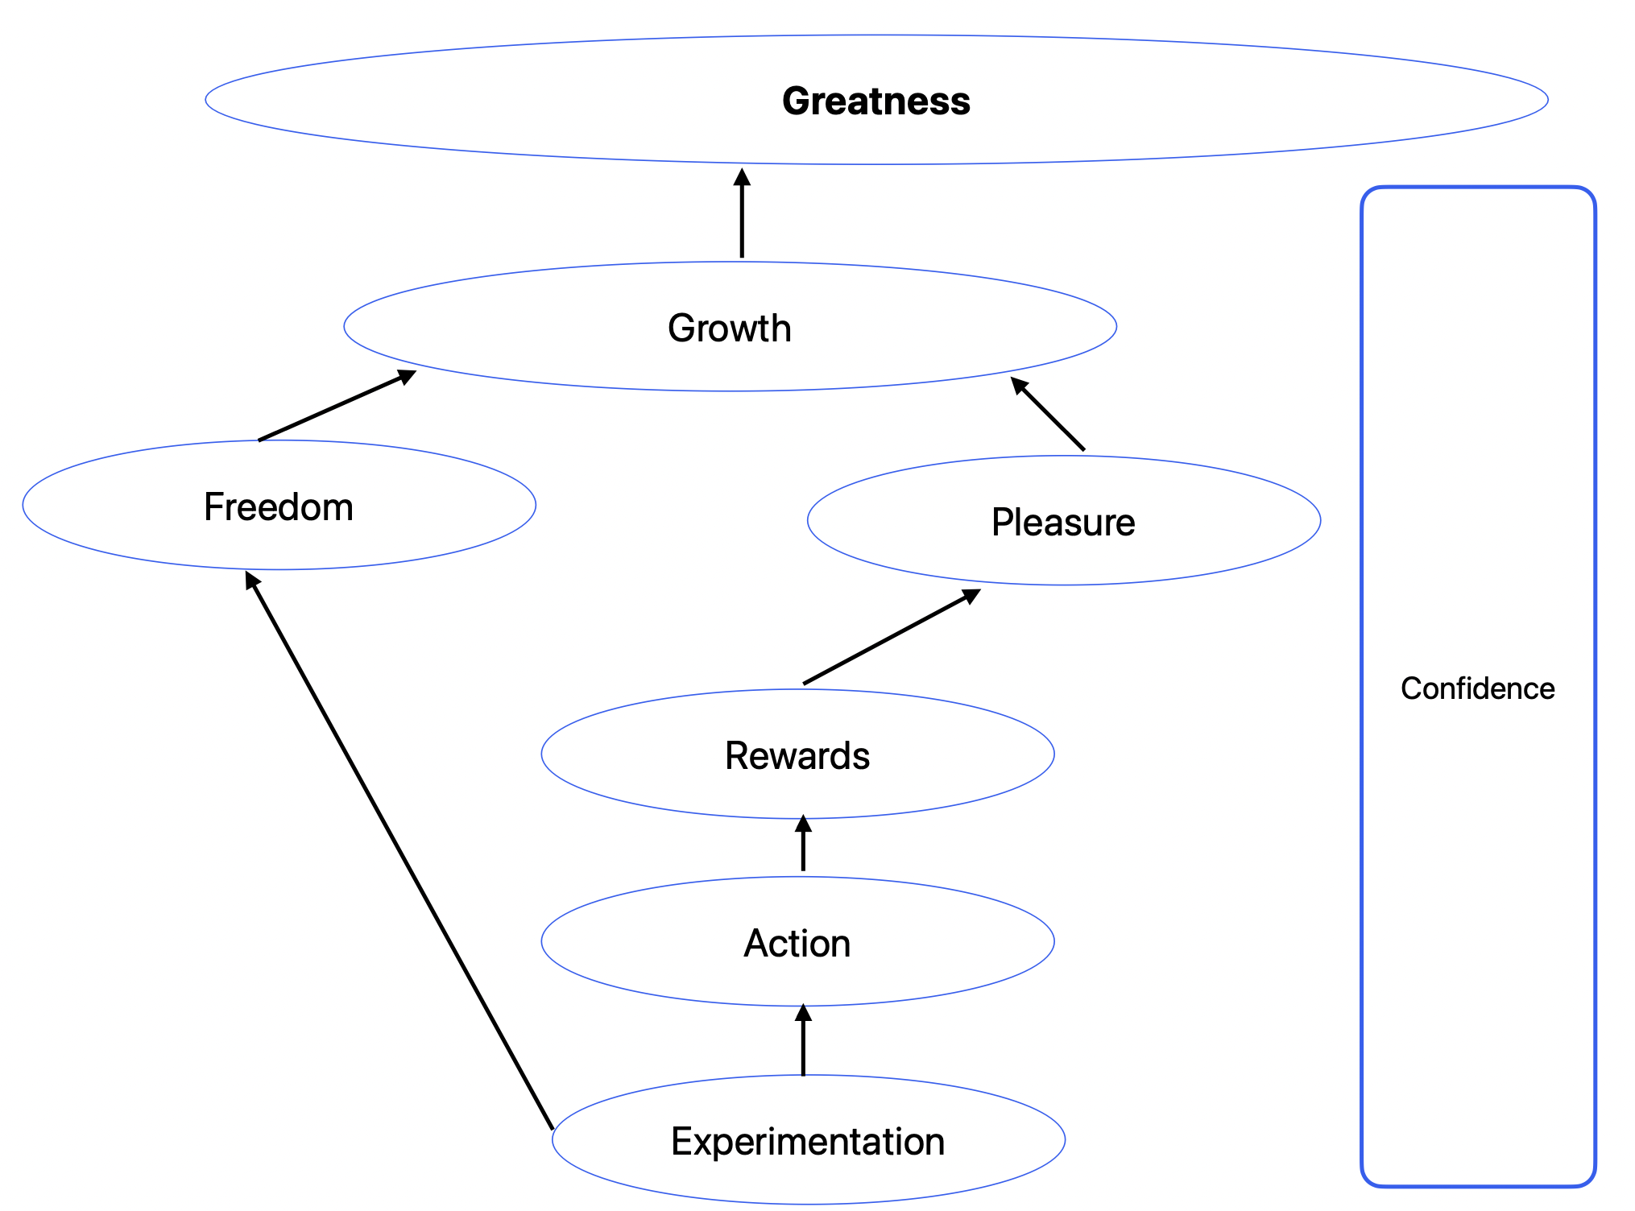
Daniel Wong

Slide 42
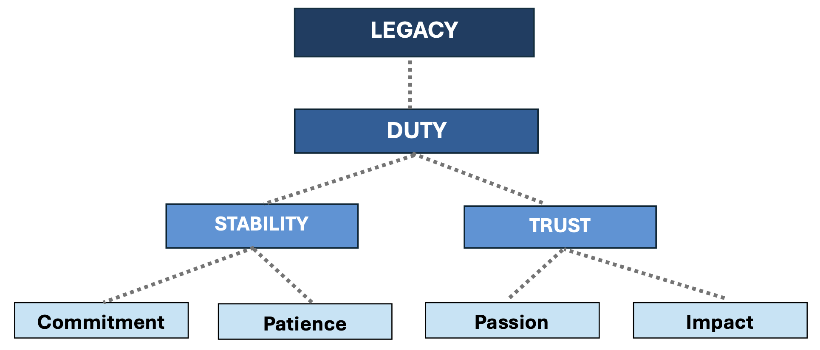
Yusuke Uchiyama

